Slide 1
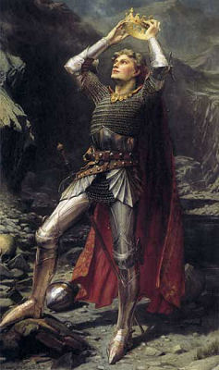
Who is King Arthur?

Slide 3
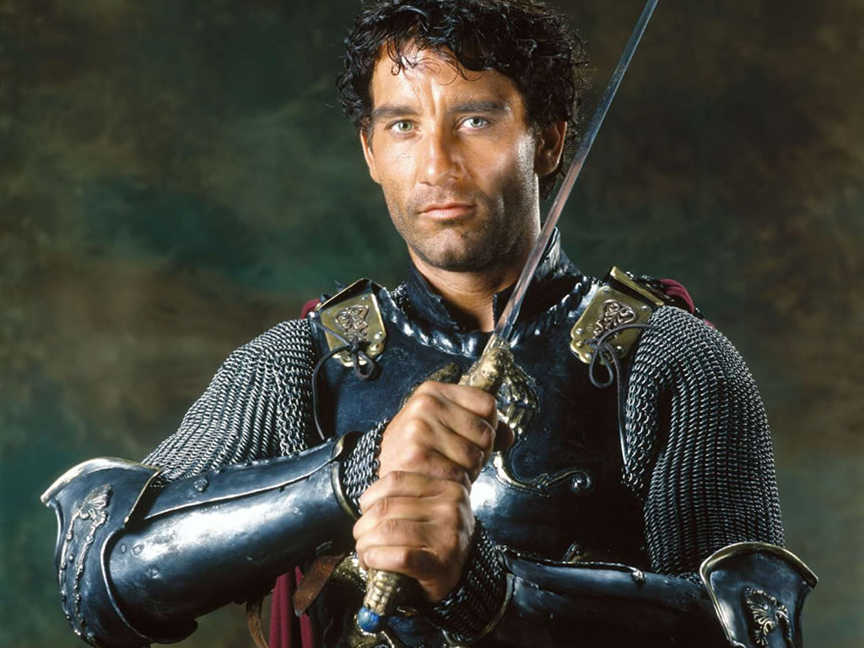
Arthur, Legendary King of Britain
~May have ruled Britain in the 5th and 6th centuries, although his existence is debated by historians
~Has been written about by many different authors, from 12th century onward
~This genre is often called Arthurian legend or Arthurian romance

Slide 4
King Arthur
~He is often characterized as a kind, noble, and brave King who protected Britain from invaders, such as the Saxons.
~According to some legends, Arthur will someday return to save his people.
~To this day, Arthur is still one of the most popular legendary figures of all time.

Slide 5
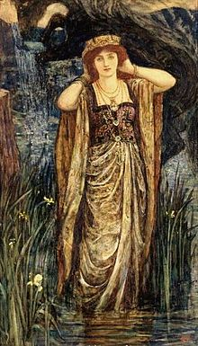
Popular Characters in Arthurian Legend
~Queen Guinevere: Arthur's beautiful but unfaithful wife
~Merlin: Wizard and advisor to Arthur
~Morgana le Fay: Sorceress and antagonist to Arthur
Queen Guinevere

Slide 6
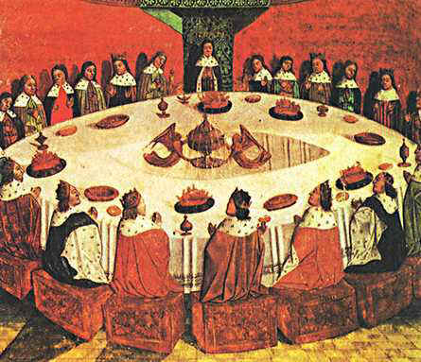
The Knights of the Round Table
~Arthur's knights sat around a Round Table, symbolizing their equal status.
~The Knights include: Sir Lancelot (who had an affair with Queen Guinevere), Sir Gawain, Sir Galahad, and many others

Slide 7
Excalibur
~Excalibur is King Arthur’s legendary sword.
~Both the sword and the scabbard (sheath which contains the sword) are said to have magical powers, protecting the sword’s bearer and harming the bearer’s opponent.

Slide 8
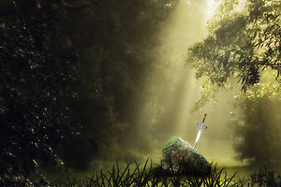
The Sword in the Stone: How Arthur Became King of Britain
When the King died, no one knew who would replace him as ruler of Britain.
A huge stone magically appeared. It had a sword stuck in it and a message stating that the only the true king could remove the sword from the stone.

Slide 9
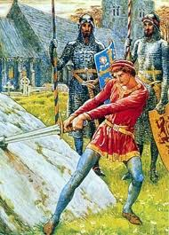
The Sword in the Stone (Cont).
Many, many people tried to remove the sword, but none succeeded.
Only the humble, teenage Arthur could achieve this feat, proving his right to rule Britain.

Slide 10
In Summary
~King Arthur is a legendary King of Britain who may or may not have existed.
~With his sword, Excalibur, by his side, he and his Knights of the Round Table protected Britain from invading Saxons.
~There are countless stories and variations on the legend of King Arthur.

Slide 11
King Arthur Information
Green, T. (2011). Arthuriana: Studies in early medieval history and legend. Retrieved from http://www.arthuriana.co.uk/

Slide 12
Media References
Arthur placing crown on head [Painting] (source unknown). http://www.factfictionandconjecture.ca/files/legend_of_king_arthur.html
National Geographic (2007). The search for king arthur. (2007). [Web Video]. Retrieved from https://www.youtube.com/watch?v=Pa4v5gH3b18
Still image from King Arthur, Buena Vista Pictures (2004). Retrieved from http://www.siue.edu/~ejoy/eng421Bibliography.htm
Guinevere [Painting] (source unknown). Retrieved from http://lily.co.ke/2011/05/03/why-men-marry-who-they-marry/queen-guinevere/
Knights of the round table [Painting]. (Source unknown). Retrieved from http://library.thinkquest.org/05aug/00158/knightsofroundtablepage1.html
The sword in the stone [We image]. (Source unknown). Retrieved from http://www.redbubble.com/people/markfaulconbridge/writing/1187073-the-sword-in-the-stone
Arthur retrieving excalibur from the stone [Painting]. (source unknown). Retrieved from http://students.ou.edu/S/Matthew.L.Seddelmeyer-1/Story%202%20Excalibur.html

